Slide 1

ECEN 480
Introduction to DSP
Lecture 8: Spectrum Analysis and DFT

Slide 2
Agenda
Prayer/Thought
Fourier Theory
CTFS
DFT
Matlab Example

Slide 3
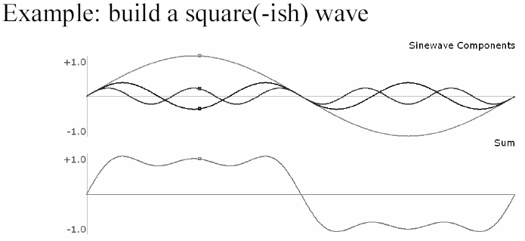
Fourier Series Analysis
What does the Fourier Series do?
Key idea - if we can reduce a complex periodic waveform to a combination of sine waves, then we can describe it using information about the frequency, amplitude and phase of each component sine wave

Slide 4
Continuous Time Fourier Series
For continuous-time signals, the Fourier series allows us to represent any periodic signal x(t) as an infinite sum of harmonically related complex exponentials or sinusoids
Can anyone remember the CTFS equations?
What if the input is not periodic?

Slide 5


Continuous Time Fourier Transform
For nonperiodic, continuous-time signals, the Fourier transform allows us to determine the frequency content of a signal x(t)
We can completely recover the original signal x(t) from the Fourier transform X(f) using The inverse Fourier transform
What if the input is discrete?

Slide 6


Discrete-Time Fourier Transform
The discrete-time equivalent of the Fourier transform, the Discrete-Time Fourier Transform (DTFT), is defined by,
The Inverse Discrete-Time Fourier Transform (IDTFT) is defined by
What if x[n] in not infinite in length?

Slide 7
Discrete Fourier Transform (DFT)
For finite-length discrete sequences, the Discrete Fourier Transform (DFT) is defined by,
The Inverse Discrete Fourier Transform (IDFT) is defined by,

Slide 8
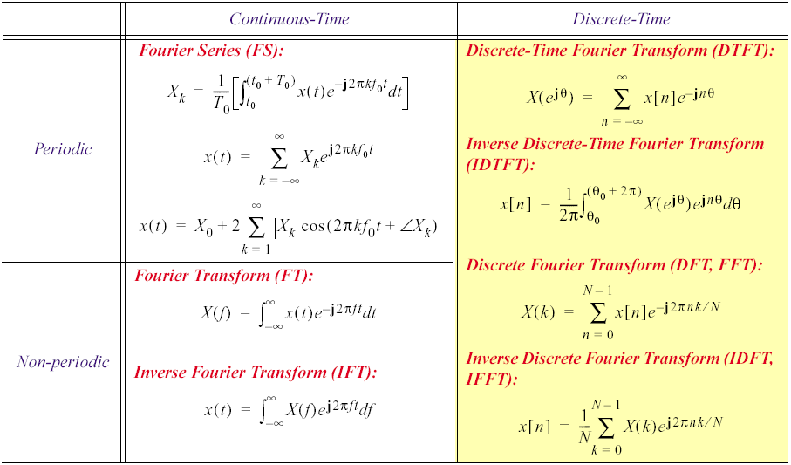
Fourier Summary

Slide 9
DFT Example
Compute the 4 point
DFT for
x[n] = {1, 1, 0, 0}
X[0]=x[0]e^{-j0}+x[1]e^{-j0}+x[2]e^{-j0}+x[3]e^{-j0}
= 1 + 1 + 0 + 0 = 2
X[1]=x[0]e^{-j0}+x[1]e^{-j2pi/4}+x[2]e^{-j2pi2/4}+x[3]e^{-j2pi3/4}
= 1 + 1e^{-jpi/2} + 0 + 0 = 1-j = 1.414-.785 rad
X[2]=x[0]e^{-j0}+x[1]e^{-j2pi2/4}+x[2]e^{-j2pi4/4}+x[3]e^{-j2pi6/4}
= 1 + 1e^{-jpi} + 0 + 0 = 1-1 = 0
X[3]=x[0]e^{-j0}+x[1]e^{-j2pi3/4}+x[2]e^{-j2pi6/4}+x[3]e^{-j2pi9/4}
= 1 + 1e^{-j3pi/2} + 0 + 0 = 1+j = 1.414 .785 rad

Slide 10
IDFT Example
Compute the 4 point
IDFT for
X[k]={20, 1.414-.785, 00, .414.785}
x[0] = 1/4(X[0]e^{-j0}+X[1]e^{-j0}+X[2]e^{-j0}+X[3]e^{-j0})
x[0] = 1
:
:
:
x[n] = {1, 1, 0, 0}

Slide 11
Spectral Analysis using the DFT
To compute the DFT in MATLAB, we use the function fft(x,n)
This function takes a waveform x and the number of samples n
When n is less than the length of x, then x is truncated
When n is longer than the length of x, then x is padded with zeros
The output is an array of complex amplitudes of length n
Note – if n is a power of 2, Matlab will use an FFT algorithm to compute the DFT
The FFT algorithm is MUCH faster computationally than the DFT
We will talk about it next time

Slide 12
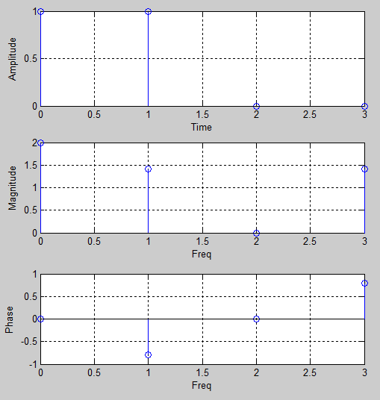
DFT Example
x[n] = {1, 1, 0, 0}
X[k]={20, 1.414-.785, 00, 1.414.785}
% generate a signal
t = 0:1:3;
x = [1 1 0 0];
% plot original signal
subplot(3,1,1), stem(t,x)
ylabel('Amplitude'), grid on
xlabel('Time')
% perform 4-point transform
z = fft(x,4);
m = abs(z);
a = angle(z);
% Plot spectrum of original signal
subplot(3,1,2), stem(t,m)
ylabel('Magnitude'), grid on
xlabel('Freq')
subplot(3,1,3), stem(t,a)
ylabel('Phase'), grid on
xlabel('Freq')

Slide 13
Spectrum Diagram Review
What is the frequency spectrum of this signal?
–4000
–1500
0
1500
4000
f (in Hz)
Lets look at this using Matlab

Slide 14
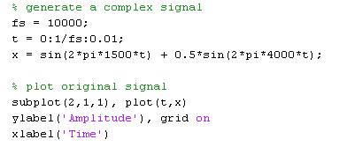
Matlab Example
How do we create a time domain signal that consists of a 1.5kHz and 4kHz sinusoid and plot it?
Why is the signal so choppy?

Slide 15
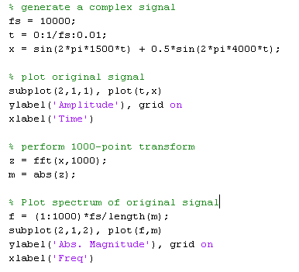
Matlab Example
How do we calc the DFT using Matlab?
What is funny about this freq plot?

Slide 16
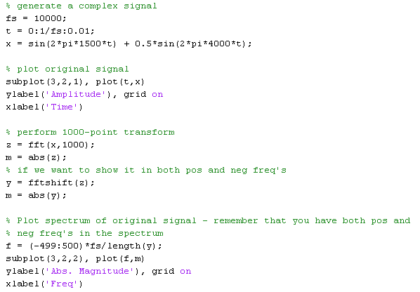
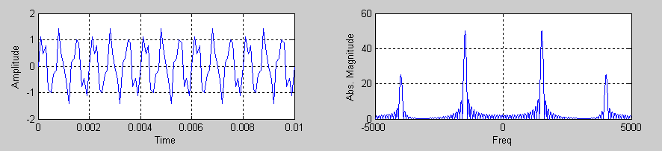
Time and Frequency Domain Signals

Slide 17
What is z?
1000 complex amplitudes
What does each value really mean?
Each value represents the mag/phase for a particular frequency

Slide 18
What is the resolution of z?
10kHz/1000 points =10Hz/point

Slide 19
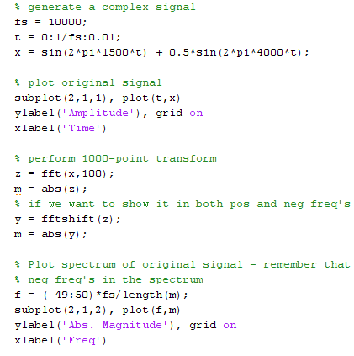
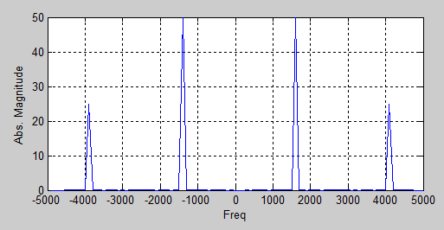
What is the resolution of z now?
10kHz/100 points =100Hz/point

Slide 20
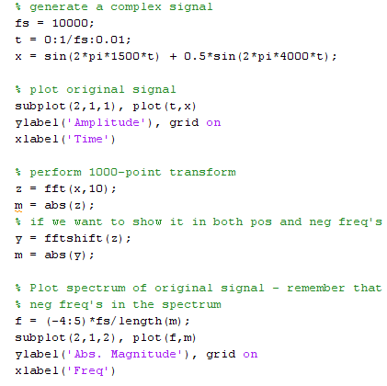
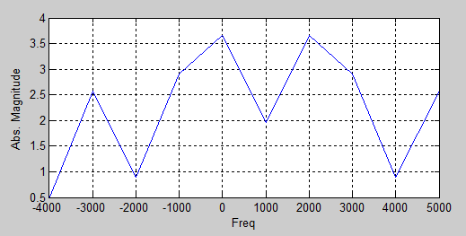
What is the resolution of z now?
10kHz/10 points =1000Hz/point
How do we determine the phase response?

Slide 21
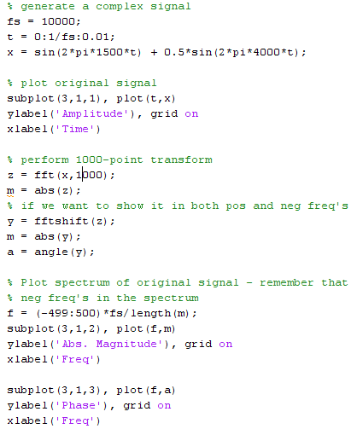
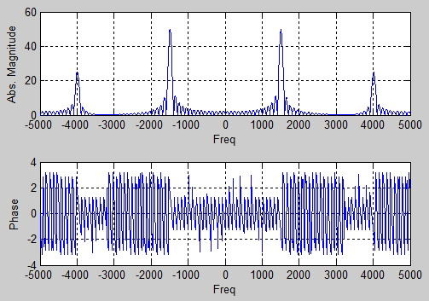
Phase Response
Why isn’t is 90 degrees?

Slide 22
Spectral Analysis using the DFT
The discrete-time discrete-frequency version of the Fourier transform (DFT) converts an array of N sample amplitudes to an array of N complex harmonic amplitudes
If the sampling rate is f_{s}, the N input samples are 1/ f_{s} seconds apart, and the harmonic frequencies are f_{s}/N hertz apart.
The N output amplitudes are evenly spaced at frequencies between 0 and (N-1) f_{s}/N hertz.

Slide 23
Lab 4
VC++ lab

Slide 24
Backup

Slide 25
Another DFT Example
x[n] was sampled at 10kHz
Compute the 5 point
DFT for
x[n] = {1, 1, 0, 0, 1, 0}
X[0]=x[0]e^{-j0}+x[1]e^{-j0}+x[2]e^{-j0}+x[3]e^{-j0}+x[4]e^{-j0}+x[5]e^{-j0}
= 1 + 1 + 0 + 0 + 1 + 0 = 3
X[1]=x[0]e^{-j0}+x[1]e^{-j2pi/5}+x[2]e^{-j2pi2/5}+x[3]e^{-j2pi3/5}+x[4]e^{-j2pi4/5}+x[5]e^{-j2pi5/5}
= 1 + 1e^{-j2pi/5} + 0 + 0 + 1e^{-j8pi/5} + 0 = 1 + e^{-j2pi/5} + e^{-j8pi/5}
X[2]=x[0]e^{-j0}+x[1]e^{-j2pi2/5}+x[2]e^{-j2pi4/5}+x[3]e^{-j2pi6/5}+x[4]e^{-j2pi8/5}+x[5]e^{-j2pi10/5}
= 1 + 1e^{-j4pi/5} + 0 + 0 + 1e^{-j16pi/5} + 0 = 1 + e^{-j4pi/5} + e^{-j16pi/5}
X[3]=x[0]e^{-j0}+x[1]e^{-j2pi3/5}+x[2]e^{-j2pi6/5}+x[3]e^{-j2pi9/5}+x[4]e^{-j2pi12/5}+x[5]e^{-j2pi15/5}
= 1 + 1e^{-j6pi/5} + 0 + 0 + 1e^{-j24pi/5} + 0 = 1 + e^{-j6pi/5} + e^{-j24pi/5}
X[4]=x[0]e^{-j0}+x[1]e^{-j2pi4/5}+x[2]e^{-j2pi8/5}+x[3]e^{-j2pi12/5}+x[4]e^{-j2pi16/5}+x[5]e^{-j2pi20/5}
= 1 + 1e^{-j8pi/5} + 0 + 0 + 1e^{-j32pi/5} + 0 = 1 + e^{-j8pi/5} + e^{-j32pi/5}

Slide 26
Another DFT Example
x[n] was sampled at 10kHz
The 5 point DFT for
x[n] = {1, 1, 0, 0, 1, 0}
X[0]= 3
X[1]= 1 + e^{-j2pi/5} + e^{-j8pi/5}
X[2]= 1 + e^{-j4pi/5} + e^{-j16pi/5}
X[3]= 1 + e^{-j6pi/5} + e^{-j24pi/5}
X[4]= 1 + e^{-j8pi/5} + e^{-j32pi/5}
What does this really tell us?

Slide 27
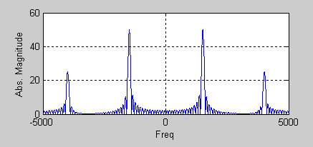
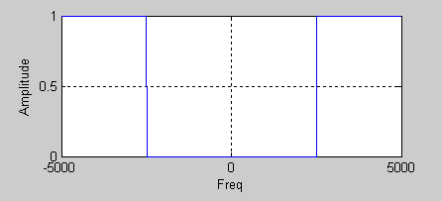
Frequency Domain Filtering
What happens if I mult, the freq domain signal by this step function?
*

Slide 28
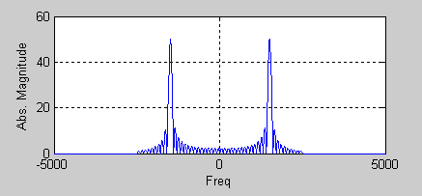
Frequency Domain Filtering
*
=
*** Remember the fftshift function

Slide 29
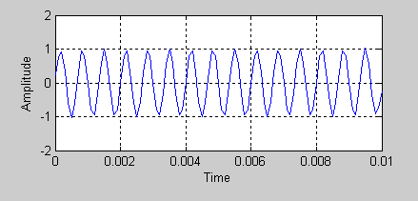
Frequency Domain Filtering
What happens if I take the ifft of this signal?
This is a way to do filtering of a signal in the frequency domain. Remember that convolution in the time domain is mult in freq domain

Slide 30
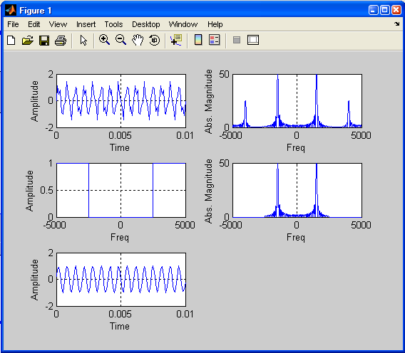
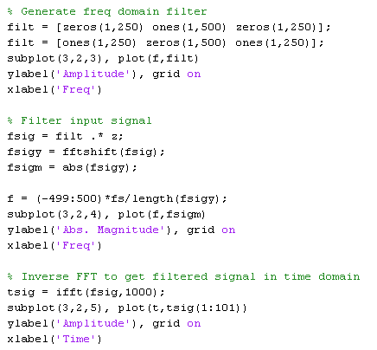
Frequency Domain Filtering

Slide 31
Another Matlab Example
% generate a complex signal
fs = 10000; % sampling rate
t = 0:1/fs:0.1; % sampling instants
x = sin(2*pi*1500*t) + sin(2*pi*4000*t); % two sinusoids
%
% perform 1000-point transform
y = fft(x,1000); % y contains 1000 complex amplitudes
m = abs(y); % m = magnitude of sinusoids
p = unwrap(angle(y)); % p = phase of sinusoids, unwrap()
% copes with 360 degree jumps
% plot first 500 points = 0..fs/2
f = (0:499)*fs/length(y);
subplot(2,1,1), plot(f,m(1:500)) % plot magnitudes
ylabel('Abs. Magnitude'), grid on
subplot(2,1,2), plot(f,p(1:500)*180/pi) % plot phase in degrees
ylabel('Phase [Degrees]'), grid on
xlabel('Frequency [Hertz]')
Typically we want the magnitude or the power of a spectrum in decibels, which can be obtained with
Y=fft(x,1024);
magnitude = abs(Y);
powerdB=20*log10(magnitude+eps);

Slide 32
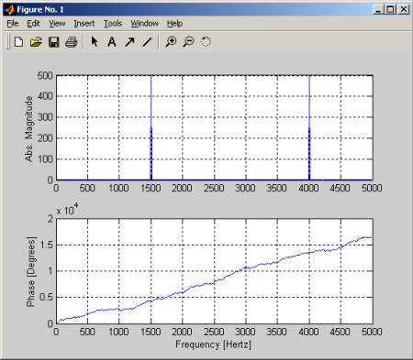
Matlab Example Cont

Slide 33
Spectral Analysis using Filter Banks
Have you ever used a spectrum analyzer? How does it work?
Another way to perform spectral analysis is to use a bank of bandpass filters.
A filterbank can be designed to provide a spectral analysis with any degree of frequency resolution (wide or narrow), and even with non-linear filter spacing and bandwidths.
A disadvantage of filterbanks is that they almost always take more calculation and processing time than discrete Fourier analysis using the FFT (see below).
To use a filter bank for analysis we need one band-pass filter per channel to do the filtering, a means to perform rectification, and a low-pass filter to smooth the energies.
In this example, we build a 19-channel filterbank using bandwidths that are modelled on human auditory bandwidths. We rectify and smooth the filtered energies and convert to a decibel scale.

Slide 34
Spectral Analysis using Filter Banks
function e=auditoryfbank(x,fs)
% AUDITORYFBANK performs an auditory filterbank analysis on a signal
% E=AUDITORYFBANK(X,FS) passes signal X, sampled at FS samples/sec through a 19-channel auditory filterbank, smoothing and
% downsampling energies to 100 frames per second. Output is in decibels.
% get output energy sample points
x=reshape(x,[length(x) 1]); % force to be a column
eidx=fs/100:fs/100:length(x); % sampling indices (100 frame/sec)
ne=length(eidx); % number of output energy frames
% these are the filter cut-offs
cuts=[180 300 420 540 660 780 900 1075 1225 1375 1525 1700 1900 2100 2300 2550 2850 3150 3475 4000];
nf=length(cuts)-1; % number of filters
% initialise the output energy table
e=zeros(ne,nf);
% build a smoothing filter
[sb,sa]=butter(4,2*50/fs); % low-pass at half output frame rate
% for each channel in turn
for i=1:nf
fprintf('Calculating channel %d (%d-%dHz)\n',i,cuts(i),cuts(i+1));
% build the band-pass filter
[b,a]=butter(4,[2*cuts(i)/fs 2*cuts(i+1)/fs]);
% filter the signal
y=filter(b,a,x);
% rectify and smooth
sy=filter(sb,sa,abs(y));
% sample and convert to decibels
sy=max(sy,eps); % force to be > 0
e(:,i)=100+20*log10(sy(eidx)); % downsample and convert to dB
end

Slide 35

Windowing a Signal
Often we want to analyze a long signal in overlapping short sections called “windows”.
For example we may want to calculate an average spectrum, or to calculate a spectrogram.
Unfortunately we cannot simply chop the signal into short pieces because this will cause sharp discontinuities at the edges of each section.
Instead it is preferable to have smooth joints between sections.
Raised cosine windows are a popular shape for the joints

Slide 36
Windowing a Signal
You can use the MATLAB function hamming() to design smooth windows of a given length, and then you can use code such as the following to divide the signal into sections
% divide up a signal into windows
x = sin(2*pi*500*(1:10000)/10000); % example signal
nx = length(x); % size of signal
w = hamming(32)'; % hamming window
nw = length(w); % size of window
pos=1;
while (pos+nw <= nx) % while enough signal left
y = x(pos:pos+nw-1).*w; % make window y
%%%% process window y %%%%
pos = pos + nw/2; % next window
end

